Slide 1

DIVINE GRACE COLLEGE OF ARTS, SCIENCE AND TECHNOLOGY
(DGCAST) — GAROUA | GEOGRAPHY DEPARTMENT
UPPER SIXTH ARTS — SETTLEMENT GEOGRAPHY — LESSON 19
Bid Rent and Functional Segregation
Mr KAMDEM EMMANUEL
Geography Teacher — PLEG
Academic Year 2026 / 2027
Notes:
Good morning, class. Today we study Lesson 19: Bid Rent and Functional Segregation.

Slide 2
GEOGRAPHY — UPPER SIXTH ARTS
CLASS INFO
Class, Chapter & Duration
Class | Upper Sixth Arts
Chapter | Module 5: Understanding and managing settlement dynamics across the world in general and Cameroon in particular
Duration | 2 periods (2 × 50 minutes)
2026 / 2027
DGCAST GAROUA — GEOGRAPHY DEPARTMENT
Mr KAMDEM E. | 2

Slide 3
GEOGRAPHY — UPPER SIXTH ARTS
IDENTIFICATION
Lesson Identification
Topic | Internal City Structure
Sub-topic | Internal City Structure
Lesson | Lesson 19: Bid Rent and Functional Segregation
Notions / Concepts | Bid rent, land value, accessibility, functional segregation, social segregation.
Syllabus focus | Bid rent theory: land value falling with distance from the CBD; bid rent curves; other factors (government, planning, relief, social segregation); effects on housing and activities.
Competence | Learners are able to explain land use zones in cities with bid rent theory.
2026 / 2027
DGCAST GAROUA — GEOGRAPHY DEPARTMENT
Mr KAMDEM E. | 3

Slide 4
GEOGRAPHY — UPPER SIXTH ARTS
OBJECTIVES
Learning Objectives
By the end of the lesson, the learner should be able to:
Explain bid rent and land value.
Draw and read bid rent curves.
Explain other factors of segregation and their effects.
2026 / 2027
DGCAST GAROUA — GEOGRAPHY DEPARTMENT
Mr KAMDEM E. | 4

Slide 5
GEOGRAPHY — UPPER SIXTH ARTS
RECALL
Recall
Land is expensive in the CBD.
Cities have zones.
2026 / 2027
DGCAST GAROUA — GEOGRAPHY DEPARTMENT
Mr KAMDEM E. | 5

Slide 6
GEOGRAPHY — UPPER SIXTH ARTS
REAL-LIFE SITUATION
Real-Life Situation
In Douala, a small shop in Akwa pays a very high rent, while a large factory in Bassa pays less per square metre, and families find cheaper land far from the centre. Learners ask why.
2026 / 2027
DGCAST GAROUA — GEOGRAPHY DEPARTMENT
Mr KAMDEM E. | 6
Notes:
Read the situation slowly, twice.

Slide 7
GEOGRAPHY — UPPER SIXTH ARTS
REAL-LIFE SITUATION
Situation — Question 1
What is the problem in the situation?
2026 / 2027
DGCAST GAROUA — GEOGRAPHY DEPARTMENT
Mr KAMDEM E. | 7

Slide 8
GEOGRAPHY — UPPER SIXTH ARTS
REAL-LIFE SITUATION
Answer
Land prices change across the city.
2026 / 2027
DGCAST GAROUA — GEOGRAPHY DEPARTMENT
Mr KAMDEM E. | 8

Slide 9
GEOGRAPHY — UPPER SIXTH ARTS
REAL-LIFE SITUATION
Situation — Question 2
Where is land most expensive?
2026 / 2027
DGCAST GAROUA — GEOGRAPHY DEPARTMENT
Mr KAMDEM E. | 9

Slide 10
GEOGRAPHY — UPPER SIXTH ARTS
REAL-LIFE SITUATION
Answer
In the centre, the most accessible place.
2026 / 2027
DGCAST GAROUA — GEOGRAPHY DEPARTMENT
Mr KAMDEM E. | 10

Slide 11
GEOGRAPHY — UPPER SIXTH ARTS
REAL-LIFE SITUATION
Situation — Question 3
Which theory explains this?
2026 / 2027
DGCAST GAROUA — GEOGRAPHY DEPARTMENT
Mr KAMDEM E. | 11

Slide 12
GEOGRAPHY — UPPER SIXTH ARTS
REAL-LIFE SITUATION
Possible Answer
Bid rent theory.
2026 / 2027
DGCAST GAROUA — GEOGRAPHY DEPARTMENT
Mr KAMDEM E. | 12

Slide 13
GEOGRAPHY — UPPER SIXTH ARTS
JUSTIFICATION
Justification of the Lesson
This lesson helps us to understand why activities occupy different parts of a city.
2026 / 2027
DGCAST GAROUA — GEOGRAPHY DEPARTMENT
Mr KAMDEM E. | 13

Slide 14
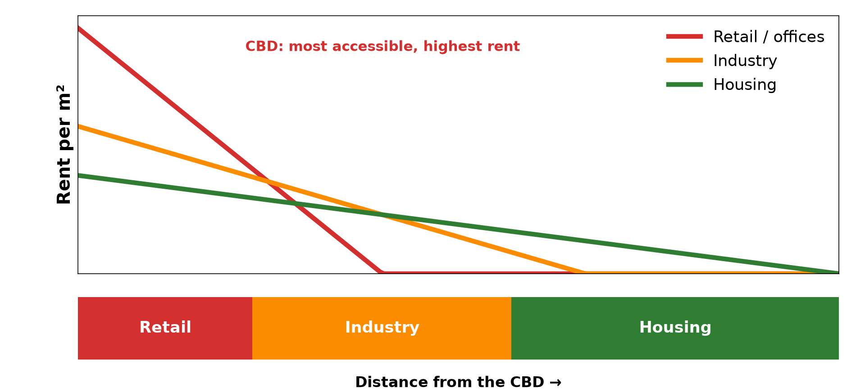
GEOGRAPHY — UPPER SIXTH ARTS
I. BID RENT
Activity 1
Bid rent curves.
2026 / 2027
DGCAST GAROUA — GEOGRAPHY DEPARTMENT
Mr KAMDEM E. | 14
Notes:
Without the projector: draw the three curves.

Slide 15
GEOGRAPHY — UPPER SIXTH ARTS
I. BID RENT
Activity 1: Question
Why can shops pay the highest rents in the CBD?
2026 / 2027
DGCAST GAROUA — GEOGRAPHY DEPARTMENT
Mr KAMDEM E. | 15

Slide 16
GEOGRAPHY — UPPER SIXTH ARTS
I. BID RENT
Answer
They need many customers, and the centre is most accessible.
2026 / 2027
DGCAST GAROUA — GEOGRAPHY DEPARTMENT
Mr KAMDEM E. | 16

Slide 17

GEOGRAPHY — UPPER SIXTH ARTS
I. BID RENT
Activity 2
Tall buildings in the CBD.
2026 / 2027
DGCAST GAROUA — GEOGRAPHY DEPARTMENT
Mr KAMDEM E. | 17
Notes:
Without the projector: compare building heights.

Slide 18
GEOGRAPHY — UPPER SIXTH ARTS
I. BID RENT
Activity 2: Question
Why are buildings tall in the CBD?
2026 / 2027
DGCAST GAROUA — GEOGRAPHY DEPARTMENT
Mr KAMDEM E. | 18

Slide 19
GEOGRAPHY — UPPER SIXTH ARTS
I. BID RENT
Answer
Land is expensive, so owners build upwards.
2026 / 2027
DGCAST GAROUA — GEOGRAPHY DEPARTMENT
Mr KAMDEM E. | 19

Slide 20

GEOGRAPHY — UPPER SIXTH ARTS
II. SEGREGATION
Activity 3
A poor quarter.
2026 / 2027
DGCAST GAROUA — GEOGRAPHY DEPARTMENT
Mr KAMDEM E. | 20
Notes:
Without the projector: describe rich and poor quarters.

Slide 21
GEOGRAPHY — UPPER SIXTH ARTS
II. SEGREGATION
Activity 3: Question
What is social segregation?
2026 / 2027
DGCAST GAROUA — GEOGRAPHY DEPARTMENT
Mr KAMDEM E. | 21

Slide 22
GEOGRAPHY — UPPER SIXTH ARTS
II. SEGREGATION
Answer
The separation of rich and poor groups in different areas.
2026 / 2027
DGCAST GAROUA — GEOGRAPHY DEPARTMENT
Mr KAMDEM E. | 22

Slide 23

GEOGRAPHY — UPPER SIXTH ARTS
III. OTHER FACTORS
Activity 4
A city in hilly relief.
2026 / 2027
DGCAST GAROUA — GEOGRAPHY DEPARTMENT
Mr KAMDEM E. | 23
Notes:
Without the projector: discuss your town.

Slide 24
GEOGRAPHY — UPPER SIXTH ARTS
III. OTHER FACTORS
Activity 4: Question
How can relief affect land use in a city?
2026 / 2027
DGCAST GAROUA — GEOGRAPHY DEPARTMENT
Mr KAMDEM E. | 24

Slide 25
GEOGRAPHY — UPPER SIXTH ARTS
III. OTHER FACTORS
Answer
Steep slopes and swamps are avoided or used by the poor.
2026 / 2027
DGCAST GAROUA — GEOGRAPHY DEPARTMENT
Mr KAMDEM E. | 25

Slide 26
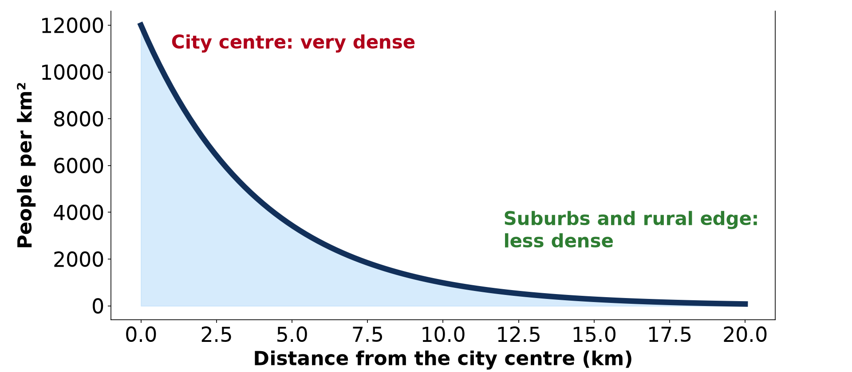
GEOGRAPHY — UPPER SIXTH ARTS
IV. EFFECTS
Activity 5
Density falls from the centre.
2026 / 2027
DGCAST GAROUA — GEOGRAPHY DEPARTMENT
Mr KAMDEM E. | 26
Notes:
Without the projector: link to density.

Slide 27
GEOGRAPHY — UPPER SIXTH ARTS
IV. EFFECTS
Activity 5: Question
How does bid rent affect population density?
2026 / 2027
DGCAST GAROUA — GEOGRAPHY DEPARTMENT
Mr KAMDEM E. | 27

Slide 28
GEOGRAPHY — UPPER SIXTH ARTS
IV. EFFECTS
Answer
High rents near the centre lead to dense housing or flats.
2026 / 2027
DGCAST GAROUA — GEOGRAPHY DEPARTMENT
Mr KAMDEM E. | 28

Slide 29
GEOGRAPHY — UPPER SIXTH ARTS
BOARD SUMMARY
Bid Rent and Functional Segregation
Topic: Internal City Structure
Sub-topic: Internal City Structure
Lesson 19: Bid Rent and Functional Segregation
2026 / 2027
DGCAST GAROUA — GEOGRAPHY DEPARTMENT
Mr KAMDEM E. | 29
Notes:
Learners copy the board summary now. Give them enough time for each slide.

Slide 30
GEOGRAPHY — UPPER SIXTH ARTS
BOARD SUMMARY
I. Definitions
Bid rent: It is the price a land user is willing to pay for land at a given place.
Accessibility: It is how easy it is to reach a place.
Functional segregation: It is the separation of different land uses into different zones.
2026 / 2027
DGCAST GAROUA — GEOGRAPHY DEPARTMENT
Mr KAMDEM E. | 30

Slide 31
GEOGRAPHY — UPPER SIXTH ARTS
BOARD SUMMARY
II. Bid Rent Theory (1/2)
A. Principle: Land value is highest at the most accessible point, the CBD. It falls with distance from the centre.
B. Curves: Shops and offices have steep curves and win the centre. Industry is next, and housing takes cheaper land further out.
2026 / 2027
DGCAST GAROUA — GEOGRAPHY DEPARTMENT
Mr KAMDEM E. | 31

Slide 32
GEOGRAPHY — UPPER SIXTH ARTS
BOARD SUMMARY
II. Bid Rent Theory (2/2)
C. Secondary peaks: Road junctions and suburban centres have higher values. They form small peaks on the curve.
2026 / 2027
DGCAST GAROUA — GEOGRAPHY DEPARTMENT
Mr KAMDEM E. | 32

Slide 33
GEOGRAPHY — UPPER SIXTH ARTS
BOARD SUMMARY
III. Other Factors and Effects (1/3)
A. Other factors: Government planning, zoning laws and relief change land use. Social segregation separates rich and poor.
B. Effects on housing: Near the centre there are flats or crowded housing. Far out there are larger houses and gardens.
2026 / 2027
DGCAST GAROUA — GEOGRAPHY DEPARTMENT
Mr KAMDEM E. | 33

Slide 34
GEOGRAPHY — UPPER SIXTH ARTS
BOARD SUMMARY
III. Other Factors and Effects (2/3)
C. Effects on activities: Shops and offices stay central, and industry moves to the edge. Hypermarkets use cheap land on the outskirts.
2026 / 2027
DGCAST GAROUA — GEOGRAPHY DEPARTMENT
Mr KAMDEM E. | 34

Slide 35
GEOGRAPHY — UPPER SIXTH ARTS
BOARD SUMMARY
III. Other Factors and Effects (3/3)
Copy the bid rent graph.
2026 / 2027
DGCAST GAROUA — GEOGRAPHY DEPARTMENT
Mr KAMDEM E. | 35

Slide 36
GEOGRAPHY — UPPER SIXTH ARTS
FORMATIVE EVALUATION
Formative Evaluation 1
Explain why land values fall with distance from the CBD.
2026 / 2027
DGCAST GAROUA — GEOGRAPHY DEPARTMENT
Mr KAMDEM E. | 36

Slide 37
GEOGRAPHY — UPPER SIXTH ARTS
FORMATIVE EVALUATION
Expected Answer
Accessibility falls, so land users bid less.
2026 / 2027
DGCAST GAROUA — GEOGRAPHY DEPARTMENT
Mr KAMDEM E. | 37

Slide 38
GEOGRAPHY — UPPER SIXTH ARTS
FORMATIVE EVALUATION
Formative Evaluation 2
Give two factors other than bid rent that affect land use.
2026 / 2027
DGCAST GAROUA — GEOGRAPHY DEPARTMENT
Mr KAMDEM E. | 38

Slide 39
GEOGRAPHY — UPPER SIXTH ARTS
FORMATIVE EVALUATION
Expected Answer
Planning laws and relief (also social segregation).
2026 / 2027
DGCAST GAROUA — GEOGRAPHY DEPARTMENT
Mr KAMDEM E. | 39

Slide 40
GEOGRAPHY — UPPER SIXTH ARTS
REMEDIATION
Remediation
Fill in the blanks:
The price a user will pay for land is the ______ rent.
Land value is highest in the ______.
Separation of rich and poor is ______ segregation.
2026 / 2027
DGCAST GAROUA — GEOGRAPHY DEPARTMENT
Mr KAMDEM E. | 40
Notes:
Answers: 1. bid 2. CBD 3. social

Slide 41
GEOGRAPHY — UPPER SIXTH ARTS
HOMEWORK
Homework
Ask the rent of a shop in the centre and one on the outskirts of your town. Explain the difference.
This prepares Lesson 20: Settlement Planning.
2026 / 2027
DGCAST GAROUA — GEOGRAPHY DEPARTMENT
Mr KAMDEM E. | 41
Notes:
This homework prepares the next lesson.

Slide 42
GEOGRAPHY — UPPER SIXTH ARTS
BILINGUAL GAME
Bilingual Game (Jeu Bilingue)
English | Français
Rent | Le loyer
Land value | La valeur foncière
Accessibility | L'accessibilité
Segregation | La ségrégation
Zoning | Le zonage
Outskirts | La périphérie
2026 / 2027
DGCAST GAROUA — GEOGRAPHY DEPARTMENT
Mr KAMDEM E. | 42
Notes:
Say the English word; learners give the French word, then the reverse.

Slide 43
GEOGRAPHY — UPPER SIXTH ARTS
LOGBOOK
Official Logbook (1/2)
Module / Topic | Internal City Structure
Lesson Title | Lesson 19: Bid Rent and Functional Segregation
Expected Learning Outcomes | Explain bid rent and land value. Draw and read bid rent curves. Explain other factors of segregation and their effects.
Competence | Learners are able to explain land use zones in cities with bid rent theory.
2026 / 2027
DGCAST GAROUA — GEOGRAPHY DEPARTMENT
Mr KAMDEM E. | 43

Slide 44
GEOGRAPHY — UPPER SIXTH ARTS
LOGBOOK
Official Logbook (2/2)
Matter Taught | I. Definitions: Bid rent, Accessibility, Functional segregation; II. Bid Rent Theory: Principle, Curves, Secondary peaks; III. Other Factors and Effects: Other factors, Effects on housing, Effects on activities.
Evaluation | Formative evaluation (3 questions) and remediation exercise.
Homework | Ask the rent of a shop in the centre and one on the outskirts of your town. Explain the difference.
Enrolment / Present / Absent | ____ / ____ / ____
Achievement | To be completed by the teacher after the lesson.
2026 / 2027
DGCAST GAROUA — GEOGRAPHY DEPARTMENT
Mr KAMDEM E. | 44

Slide 45
GEOGRAPHY — UPPER SIXTH ARTS
TEACHER'S NOTE
Teacher's Note
Timing: Set-up, recall 8 min | Situation 8 min | 5 activities 30 min | Board summary (copying) 30 min | Evaluation, remediation 10 min | Homework, logbook 9 min | Spare 5 min
2026 / 2027
DGCAST GAROUA — GEOGRAPHY DEPARTMENT
Mr KAMDEM E. | 45

Slide 46
GEOGRAPHY — UPPER SIXTH ARTS
REFERENCES
References
National Geography Syllabus, Sixth Forms (Lower & Upper Sixth), MINESEC/IGE/IP-SS, August 2019 — Module 5 (Settlement Geography).
Photo, Activity 2: “Central Business District” by alantankenghoe, CC BY 2.0, via Flickr (https://www.flickr.com/photos/57785759@N06/5548938771)
Photo, Activity 3: “Mathare” by Book Aid International, CC BY-NC-ND 2.0, via Flickr (https://www.flickr.com/photos/45024905@N07/4135561707)
Photo, Activity 4: “Bamenda, Cameroon” by jbdodane, CC BY-NC 2.0, via Flickr (https://www.flickr.com/photos/27998473@N02/11293877215)
Diagrams and animations: drawn for this lesson (DGCAST Geography Department).
2026 / 2027
DGCAST GAROUA — GEOGRAPHY DEPARTMENT
Mr KAMDEM E. | 46

